Slide 1


Slide 2


Project Title
Second Year Project
Submitted by
ROLL | NAME
2301010300 | HIMANI TYAGI
2301010303 | ISHIKA
2301010331 | KAVYA
2301010332 | SAHIL
Industry Mentor:MR JITENDAR TYAGI
Faculty Mentor:DR AMAN JATIN
Notes:
New Courses replaced with New Programmes

Slide 3

Project Overview
This presentation will discuss a project on developing an Inventory management system to optimize the tracking, management, and control of inventory within an organization. This project is a web-based project. The system will provide real-time data on stock levels, automate order processes, and improve overall operational efficiency.
The project aims to help
• to keep the stock count updated.
• to get the best return on investment from the stock.
• to manage the orders, storage and carrying the costs of inventory.
• to ensure all kinds of materials are accessible.
Users will be provided by the facility to register, to log in to the app.We’ll focus on the main goals of the project, such as reducing mistakes, and avoiding wasted stock.
Notes:
New Courses replaced with New Programmes

Slide 4
About the Problem
Most of the Retailers do not have a proper management system to maintain the inventory records and it is difficult for them to store the data in a paper file or as a hard copy and also difficult to go through the inventory data quickly and hard to maintain the data safely as they do not maintain the inventory data properly.
Lack of Inventory Visibility.
Keeping up with Overstocks.
Inefficient Inventory Management Process or Software.
Identifying Incorrectly Located Material.
Managing Inventory Waste & Defects
Notes:
New Courses replaced with New Programmes

Slide 5
Problem Statement
The retailers generally facing issues in recording the stocks and its threshold limit available. The retailers doesn't know which product is getting expired and when it is being expired. The retailers couldn't track the availability of all the stocks up-to date. The customers are not satisfied with the retailer store since it doesn't have enough supplements and the deliveries were not made on time.
The mentioned are crucial because they directly impact the efficiency of the retail business, customer satisfaction, the profitability of the store.
Solving these problems will result in increased sales, higher profit margins, better customer loyalty, Improved Operational Efficiency, Better Customer Satisfaction, Better Management of Expiring Products, Reduced Overstocking and stockouts
Notes:
New Courses replaced with New Programmes

Slide 6
Objectives
The main goad of the project is to develop and implement a user friendly website that performs the process of tracking. Managing and controlling the inventory.
Key objectives of the project:
Accurate Real-time inventory tracking
Stock alerts when inventory quantity is row or high
Expiration date management
Cost control
Stock rotation to ensure older products are sold first
User friendly interface
Notes:
New Courses replaced with New Programmes

Slide 7
Methodology, Tools, and Techniques used
The development of the Inventory Management System followed a modular and iterative development methodology, primarily inspired by the Agile approach. The focus was on creating a user-friendly, responsive, and functional web application that could handle inventory operations efficiently. The project was structured into multiple phases: planning, designing, development, testing, and deployment. Each phase was refined based on feedback and testing, allowing continuous improvement and enhancement of the application features.
Technologies used in the project include:
HTML & CSS: For structuring and styling the web pages.
JavaScript: For adding dynamic behaviors and interactivity.
MongoDB: Used as the backend database to store inventory data in a flexible, document-oriented format.
XAMPP Server: Utilized for local testing and hosting of the backend (mainly the Apache server and MySQL if required).
VS Code: The main code editor for writing and organizing code efficiently.
Adobe Tools: Used for designing UI/UX elements, creating graphics, and preparing visual content for the web pages.
Notes:
New Courses replaced with New Programmes

Slide 8
Procedure
Requirement Analysis & Planning
Identified core functionalities such as inventory tracking, adding/deleting items, updating stock, and generating reports.
Outlined the tech stack and tools required.
UI/UX Design
Created wireframes and layout designs using Adobe XD/Illustrator.
Focused on intuitive navigation and clean visual design for a better user experience.
Frontend Development
Used HTML to create the structure of the website.
Styled components with CSS for layout, colors, and responsiveness.
Implemented interactivity using JavaScript, including form validation and dynamic DOM updates.
Backend & Database Setup
Installed and configured XAMPP Server for running the development environment locally.
Integrated MongoDB as the database, with collections structured to store products, categories, stock levels, and transaction history.
Used basic CRUD operations to interact with the database and ensure data persistence.
Notes:
New Courses replaced with New Programmes

Slide 9
Output
Project Output: Inventory Management System
The Inventory Management System project was designed and developed to streamline the tracking, management, and overall organization of stock items in a simple and user-friendly web application. Here's a breakdown of the final output:
Homepage: The homepage gives users a clean, welcoming intro to the system. It provides quick navigation to major features with a minimalist design, keeping it easy on the eyes and hard to mess up (because honestly, who has time to get lost?).
Login Page: Users can securely log in to access their personal dashboard. Validation is in place to ensure only authorized users get the VIP access — no crashers allowed.
Tracking Page: This is where the real magic happens. Users can track all inventory items in real-time, including stock levels, item statuses, and restock alerts. Basically, it's like having superpowers over your stockroom.
Contact Page: A dedicated page where users can easily reach out for support, drop feedback, or just say hi. Because communication is key, and ghosting is so 2019.
Help Page: Got stuck? No worries. The help page provides detailed guides, FAQs, and quick tips to navigate the system smoothly — like a digital life coach for inventory management.
Notes:
New Courses replaced with New Programmes

Slide 10
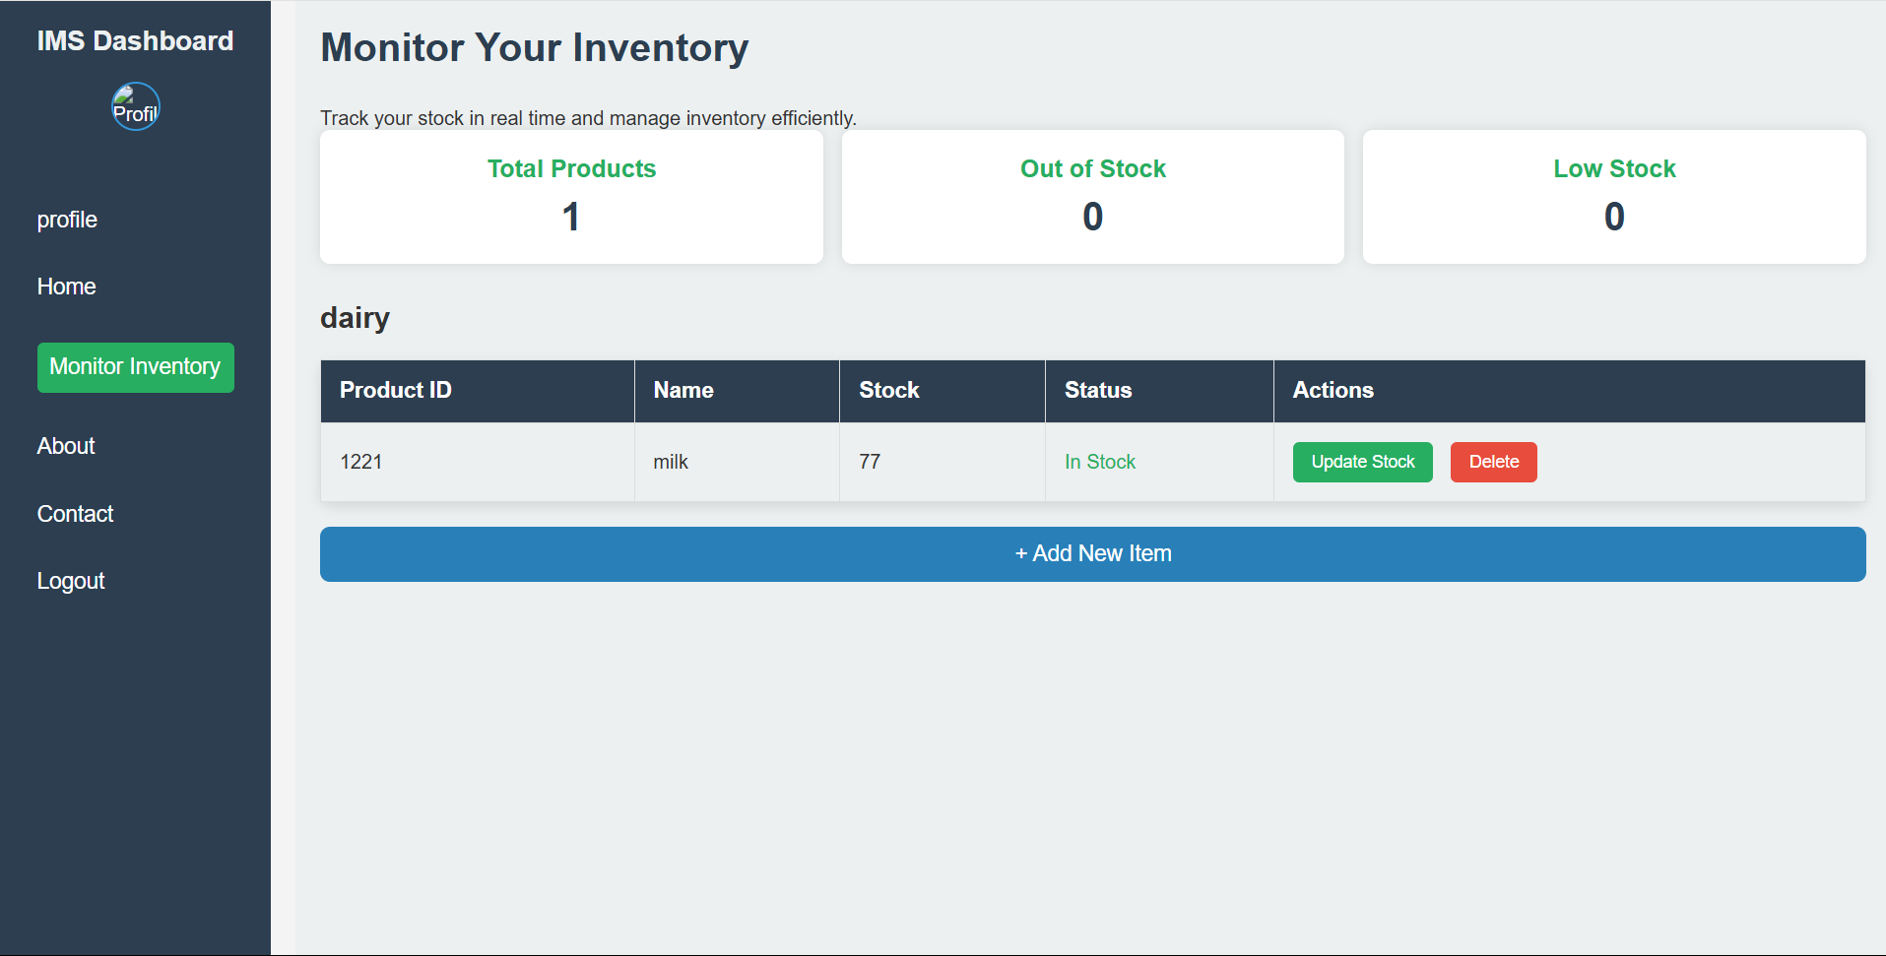
screenshots
Notes:
New Courses replaced with New Programmes

Slide 11
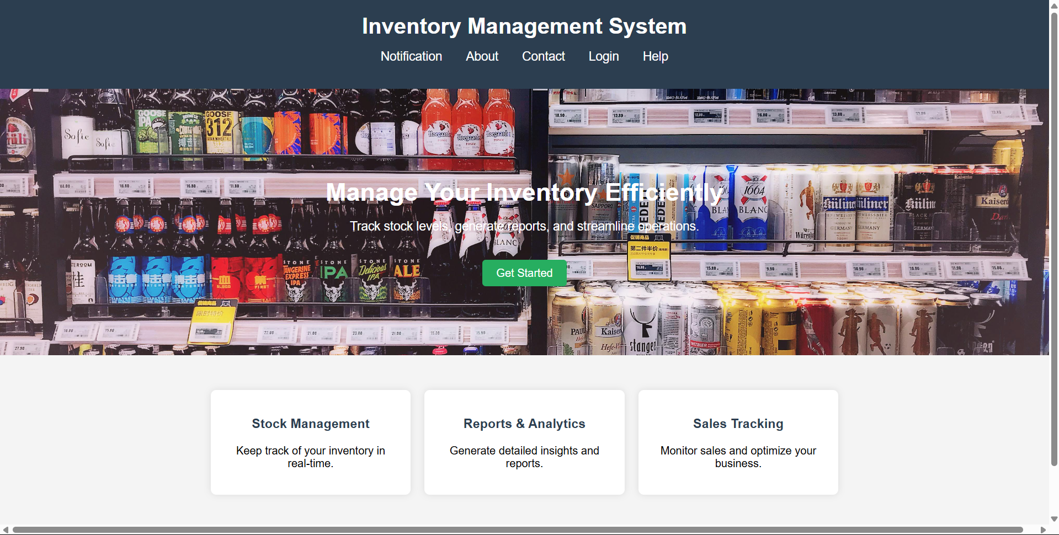
screenshots
Notes:
New Courses replaced with New Programmes

Slide 12
THANK YOU

